Slide 1

Retail Insights from Super Store Data
Pooja Preethi Mugan M
Christ College of Engineering and Technology, Moolakulam, Pondicherry

Slide 2

PROBLEM STATEMENT
Understanding sales performance, profit margins, and customer segments is crucial for making informed business decisions.
However, raw data from the Super Store lacks the organization and analysis needed to extract actionable insights.

Slide 3
Project Description
Objective: To analyze the Super Store dataset to uncover trends and insights related to sales, profit, and customer segments.
Approach: Perform data cleaning and transformation, followed by exploratory data analysis (EDA) to visualize and interpret key metrics.
Deliverables: A detailed report and a PowerPoint presentation summarizing the findings and providing actionable recommendations.

Slide 4

WHO ARE THE END USERS?
Business Analysts: To understand sales and profit trends for strategic planning.
Marketing Teams: To identify target customer segments and optimize marketing strategies.
Sales Managers: To improve sales performance and manage discounts effectively.
Supply Chain Managers: To optimize shipping modes and improve logistics efficiency.
Executives: To make informed decisions based on comprehensive data insights.

Slide 5

Technology Used
Technology Stack:
Data Analysis: Python (Pandas, NumPy)
Visualization: Matplotlib, PowerPoint
Data Storage and Processing: Excel
Presentation: Microsoft PowerPoint

Slide 6
Data Overview
Ship Mode: The shipping method used for the order (e.g., Second Class, Standard Class).
Segment: The customer segment (e.g., Consumer, Corporate).
Country: The country where the order was placed (typically "United States").
City: The city where the order was placed.
State: The state where the order was placed.
Region: The region where the order was placed (e.g., South, West).
Category: The main product category (e.g., Furniture, Office Supplies).
Sub-Category: The sub-category of the product (e.g., Bookcases, Chairs).
Sales: The sales amount for the order.
Quantity: The number of items in the order.
Discount: The discount applied to the order.
Profit: The profit from the order.

Slide 7
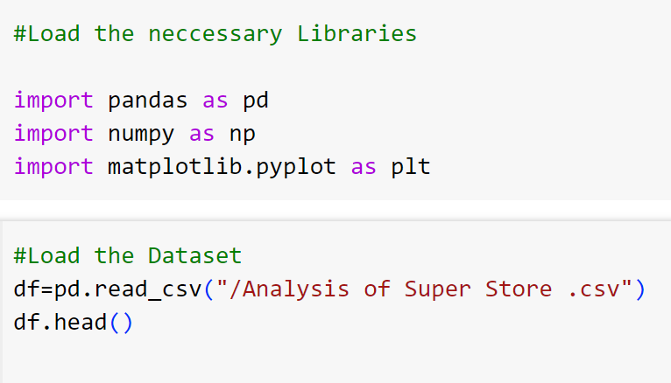
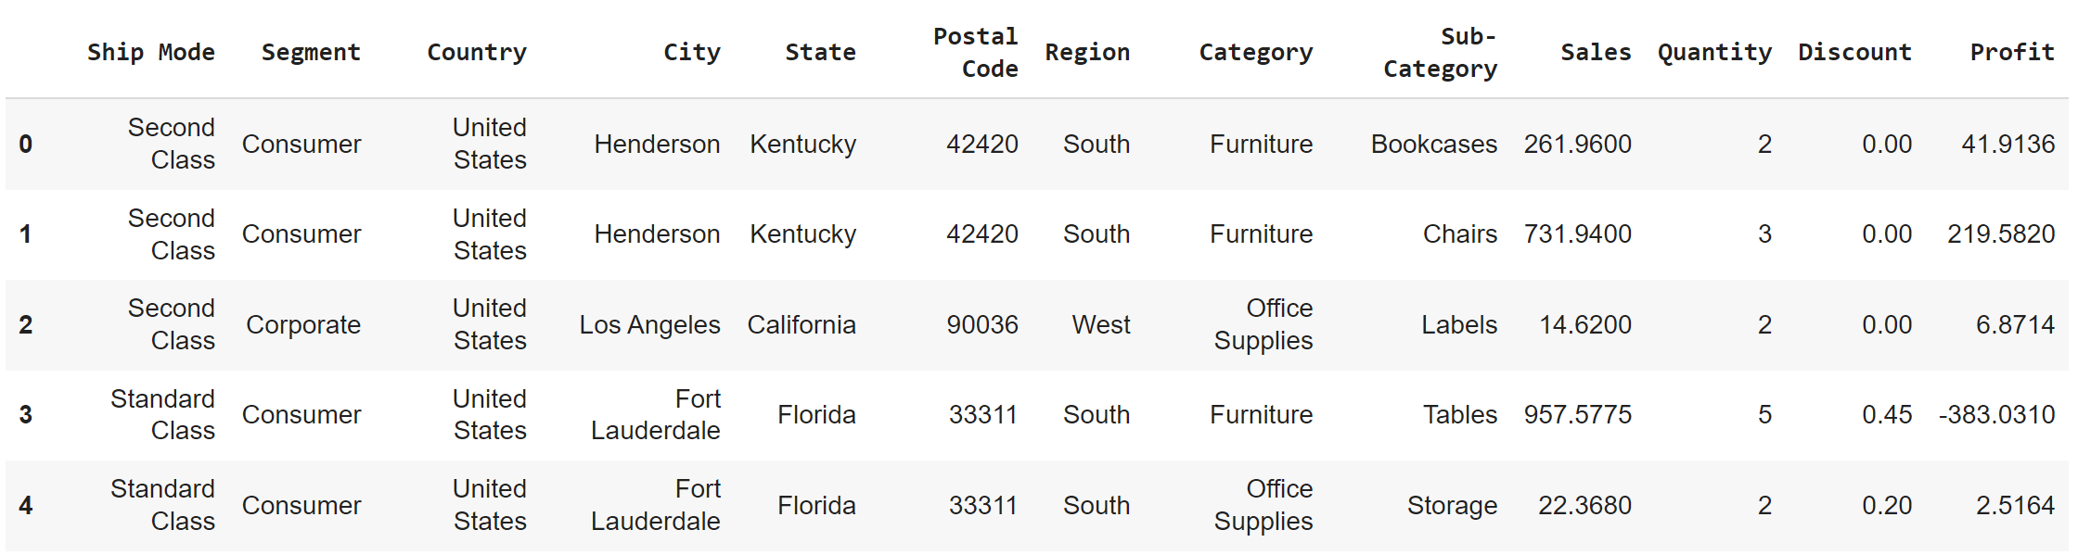
Sample Data

Slide 8
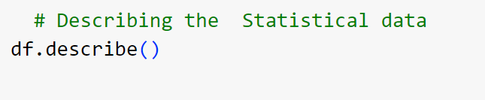
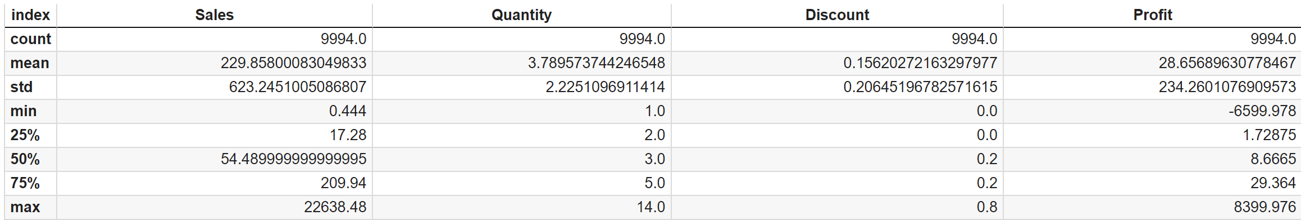
Summary Statistics

Slide 9
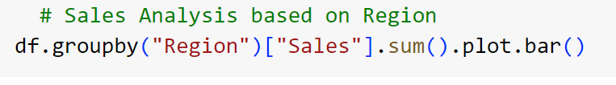

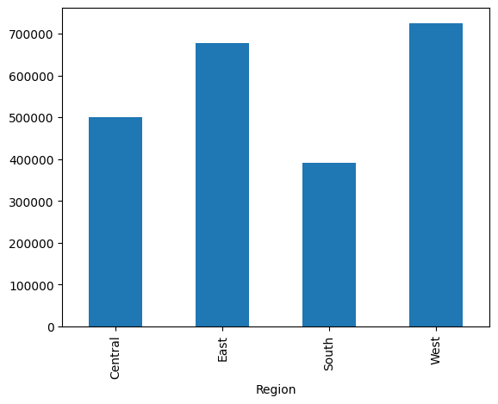
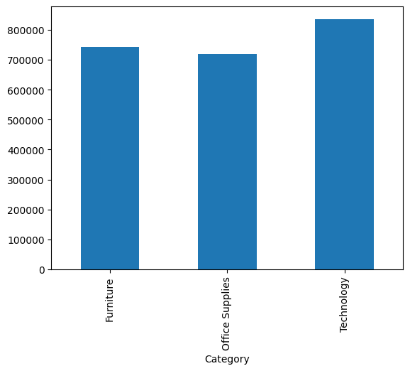
Sales Performance Analysis

Slide 10
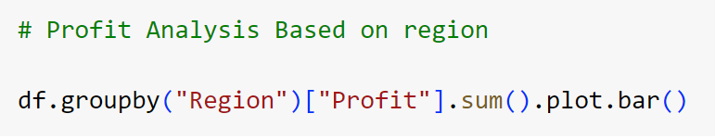
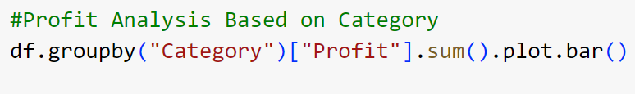
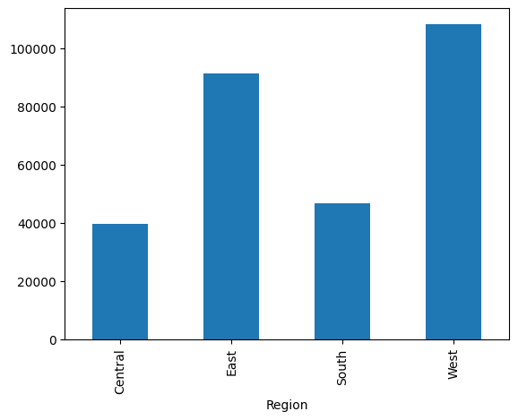
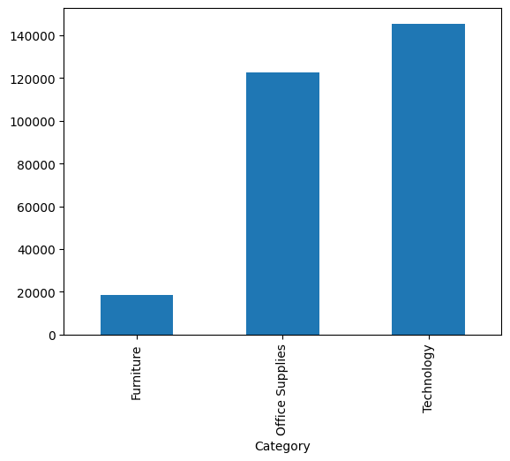
Profit Analysis

Slide 11
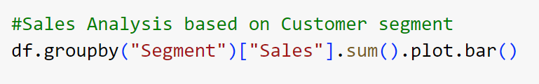

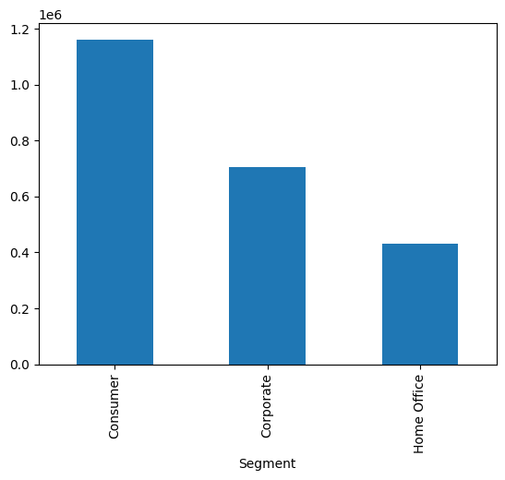
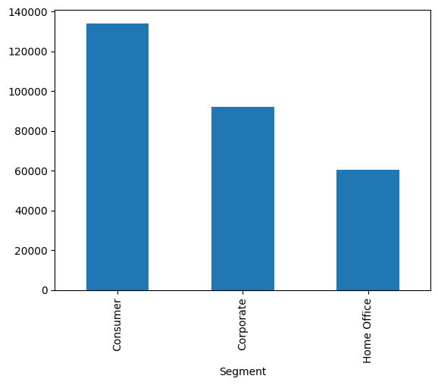
Customer Segments Analysis

Slide 12
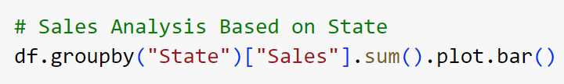
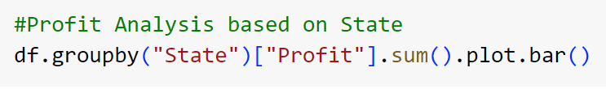
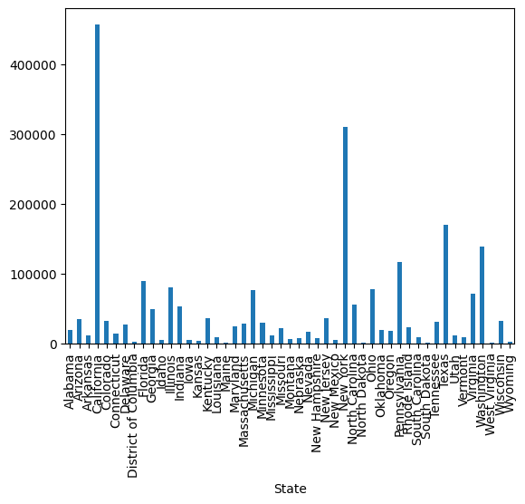
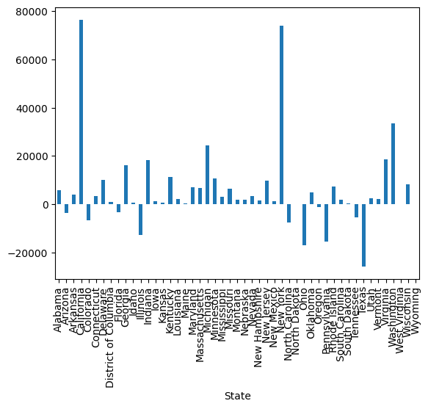
Regional Insights

Slide 13
Summary of Key Insights
Total Sales: $2297200.8603000003
Total Profit: $286,397.02
Top Sales Category: Technology
Top Customer Segment: Consumer: 5191
Most Used Shipping Mode: Standard Class : 5968
Demo Link

Slide 14
Project Information and Source Code
Source Code: Google Colab
Dataset: Analysis of Super Store
Mail: mppm167@gmail.com
AICTE Internship Student
Registration ID : STU666842a3d23121718108835

Slide 15
Thank you
.
.

